Slide 1
Splunk scheduler, concurrency and performance
Splunk Sydney User Group
Nico van der Walt
nvanderwalt@splunk.com
https://github.com/nicovdw/splunk_concurrency_helper
May 2019

Slide 3
Concurrency impact on performance
Section subtitle goes here

Slide 4

Evolution
Install Splunk
Grow
Skipped/Deferred
Increase Concurrency
Increase Quotas
Grow
SHC
Grow
Increase Quotas
Skip
Rinse/Repeat

Slide 5
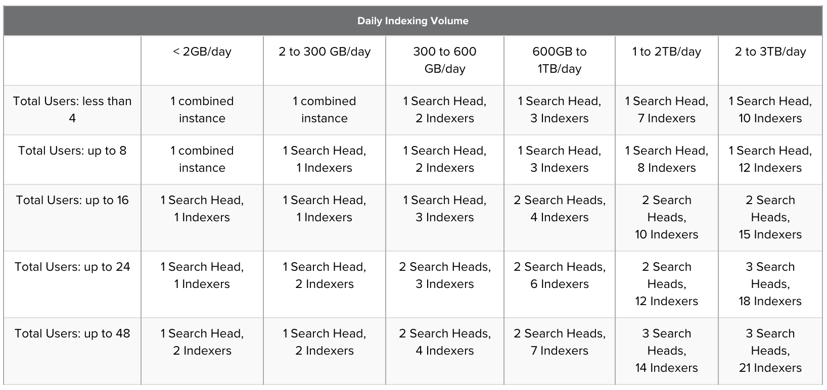
More concurrent searches, more hardware
https://docs.splunk.com/Documentation/Splunk/latest/Capacity/Summaryofperformancerecommendations

Slide 6
Concurrency Impact
Increased concurrency can lead to increased total runtime, due to resource contention
Managing concurrency can reduce system load, and increase search throughput
Each system has different threshold for performance crossover point
SSD generally allows Splunk to drive a higher concurrency

Slide 7
Splunk Scheduler Concepts

Slide 8
Homework/References
Splunk .conf 2017 – Making the most of the Splunk scheduler
https://conf.splunk.com/files/2017/slides/making-the-most-of-the-splunk-scheduler.pdf
https://conf.splunk.com/files/2017/recordings/making-the-most-of-the-splunk-scheduler.mp4
Scheduler priority scoring, windows, and skew
https://docs.splunk.com/Documentation/Splunk/latest/Report/Configurethepriorityofscheduledreports
https://docs.splunk.com/Documentation/Splunk/latest/Report/PrioritizescheduledreportsinSplunkWeb
https://docs.splunk.com/Documentation/Splunk/latest/Report/Skewscheduledreportstarttimes
Limits and savedsearches configuration spec files
https://docs.splunk.com/Documentation/Splunk/latest/Admin/Savedsearchesconf
https://docs.splunk.com/Documentation/Splunk/latest/Admin/Limitsconf
REST API Documentation
https://docs.splunk.com/Documentation/Splunk/latest/RESTUM/RESTusing https://docs.splunk.com/Documentation/Splunk/latest/RESTTUT/RESTconfigurations
https://docs.splunk.com/Documentation/Splunk/latest/RESTREF/RESTprolog

Slide 9
Concurrency Settings Basics
max_searches_per_cpu: Maximum number of concurrent searches per CPU core (default = 1).
base_max_searches: A constant added to maximum total searches (default = 6).
The total maximum number of concurrent searches allowed is calculated as follows:
max. total searches = (max_searches_per_cpu × number_of_cores + base_max_searches) × (number of cluster members)
Notes:
Why is base_max_searches = 6 by default? At one time, max_searches_per_cpu had a higher default. When it was reduced to 1, the default base_max_searches was updated to keep the search limit similar on low-core machines.
Why does the max_searches_perc setting exist? Why isn’t it always 100%? It’s to reserve CPU capacity for ad hoc searches (searches run via the UI or REST calls).

Slide 10
Saved search concurrency
max_searches_perc: Maximum number of concurrent searches the scheduler can run as a percentage of max. total searches (default = 50).
auto_summary_perc: Maximum number of concurrent summary searches (Accelerated Data Model ad accelerated search) the scheduler can run as a percentage of maximum saved searches (default = 50).
The total maximum number of concurrent saved searches allowed is calculated as follows:
Adjust number of search heads (-1) if captain is set to ad-hoc only
max. total searches = (max_searches_per_cpu × number_of_cores + base_max_searches) × (number of cluster members) * (max_searches_perc/100)
Notes:
As mentioned earlier, one of the important settings in limits.conf is max_searches_perc that sets the maximum number of concurrent searches the scheduler can run to reserve capacity for ad hoc searches.
However, during non-peak times when there are typically far fewer ad hoc searches, it’s wasteful to reserve the same percentage. Therefore, max_searches_perc can also vary by time or day.

Slide 11
Examples
 | Standalone | Clustered | Clustered | Actual Bad Example
Number of cores per SH | 32 | 32 | 32 | 36
max_searches_per_cpu | 1 | 1 | 1 | 4
base_max_searches | 6 | 6 | 6 | 40
Max searches per member | 38 | 38 | 38 | 184
max_searches_perc | 50 | 50 | 50 | 90
Max saved searches per member | 19 | 19 | 19 | 165
Number of members | N/A | 3 | 3 | 5
Number of total searches | 38 | 114 | 114 | 920
captain_is_adhoc_searchhead | N/A | false | true | false
Members executing scheduled searches | 1 | 3 | 2 | 5
Max Saved searches | 19 | 57 | 38 | 825
auto_summary_perc | 50 | 50 | 50 | 50
Max Summary searches | 9 | 27 | 18 | 410
Notes:
As mentioned earlier, one of the important settings in limits.conf is max_searches_perc that sets the maximum number of concurrent searches the scheduler can run to reserve capacity for ad hoc searches.
However, during non-peak times when there are typically far fewer ad hoc searches, it’s wasteful to reserve the same percentage. Therefore, max_searches_perc can also vary by time or day.

Slide 12
Real-time and Continuous Schedule
Deferred vs. Skipped
Real-time scheduling There are two possible scheduling modes: real-time scheduling or continuous scheduling.
A scheduled report with real-time scheduling runs at its scheduled run time, or not at all.
Real-time scheduled reports can be skipped.
Continuous scheduling
Use continuous scheduling for situations where there cannot be a gap in the collection of report data.
Continuous scheduling ensures that each scheduled run of a report is eventually performed.
If a report with continuous scheduling cannot run now, the status of the report will be continued or deferred, and it will run in the future, after other reports finish.
The report scheduler gives all scheduled reports the real-time scheduling mode by default, unless they are enabled for summary indexing, in which case it changes their scheduling mode to continuous.
The report scheduler always prioritizes reports with real-time scheduling over reports with continuous scheduling.
Time
Notes:
In this example, the quota works out to four searches running concurrently.
In the Deferred case, S5 can not run until a “run slot” is free. The scheduler attempts (and fails) to run S5 a number of times. Finally, it succeeds because S4 completed and freed a slot.
In the Skipped case, S5 can’t be run at all because no slot becomes free during its period. It is therefore skipped.

Slide 13
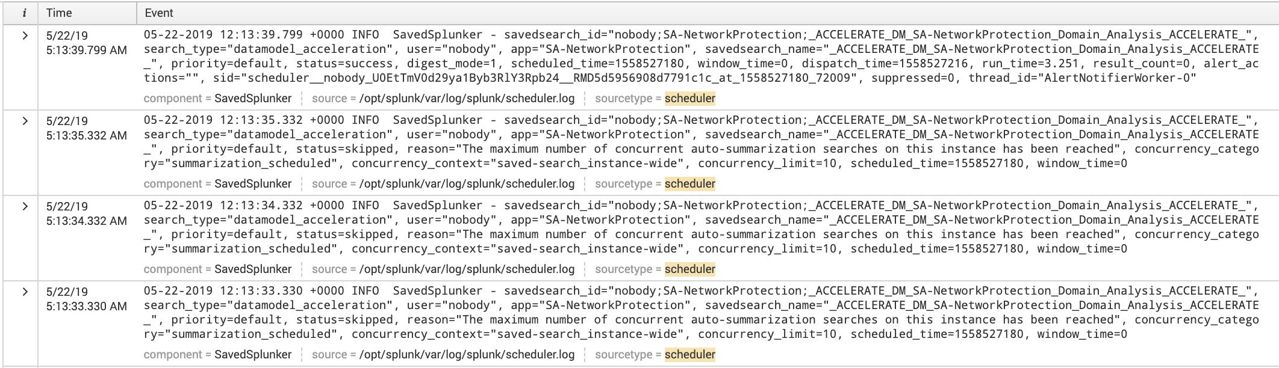
Counting DMA skipped searches
Skipped!=Skipped
Skipped DMA searches retry every second, and each retry logs as skipped
One DMA search delayed by 50 seconds can generate 50 “Skipped” messages, even though it was ultimately completed successfully
Exclude DMA from skipped search analysis
Evaluate “real” DMA success by calculating latest(info) by savedsearch_name scheduled_time
All the same unique scheduled search

Slide 14
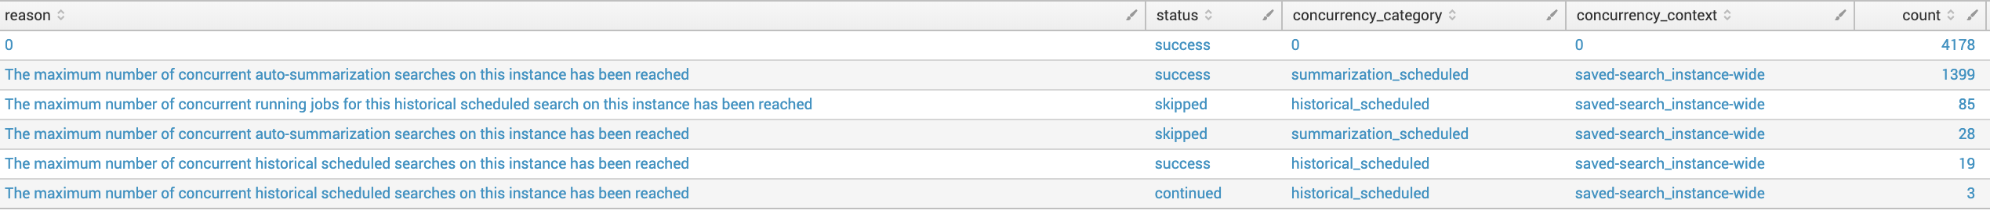
Counting DMA skipped searches
Skipped!=Skipped
index=_internal host=<search heads> sourcetype=scheduler (status=success OR status="skipped" OR status="deferred" OR status=continued)
|stats latest(status) as status latest(reason) as reason latest(concurrency_category) as concurrency_category latest(concurrency_context) as concurrency_context latest(concurrency_limit) as concurrency_limit by savedsearch_name scheduled_time |fillnull
|stats count by reason status concurrency_category concurrency_context concurrency_limit |sort – count
index=_internal host=<search heads> sourcetype=scheduler (status="skipped" OR status="deferred" OR status=continued)
|stats count by reason status concurrency_category concurrency_context
|sort - count

Slide 15
Skipped Search Reasons
Not all skipped searches indicate concurrency limit reached
Searches running longer than schedule interval
The maximum number of concurrent running jobs for this historical scheduled search on this [instance | cluster] has been reached
User quota
The maximum disk usage quota for this user has been reached. Use the Job Manager to delete some of your saved search results.
The maximum number of concurrent historical searches for this user based on their role quota has been reached.
User Permission
user=username is not allowed to run historical scheduled search
Data model acceleration retries
The maximum number of concurrent auto-summarization searches on this [instance | cluster] has been reached
Actual Concurrency reached
The maximum number of concurrent [historical scheduled | real-time scheduled] searches on this [instance | cluster] has been reached

Slide 16
Schedule Window
You can apply a scheduling window to reports that do not need to run at their scheduled start times.
Gives the report scheduler more flexibility to schedule reports that require more precision.
The scheduler adds the schedule window timespan to the priority score for the report, temporarily increasing that score (lower scores have higher priority).
The window opens at the report's scheduled run time.
The scheduled report's higher priority score allows reports with lower scores to run ahead of it.
As time passes and the schedule window narrows, the report's priority score improves until the report is allowed to run.
Schedule Priority and Schedule Window settings are mutually exclusive.
If a scheduled report has both a Schedule Priority of Higher or Highest and a defined Schedule Window, the search scheduler prioritizes the report according to the Schedule Priority value and ignores the Schedule Window definition.

Slide 17
Allow Skew
The scheduler attempts to run all searches as soon as possible after the zeroth second of the minute it was scheduled.
Multiple searches all starting at approximately the same moment can cause the CPU, Disk I/O or network to be overloaded briefly.
The allow_skew setting offsets the actual start time of a scheduled search from its scheduled run time by a random amount of time.
When the scheduler applies allow_skew to a large number of searches that are running on the same schedule, the randomness of the offset for each search contributes to an even distribution of actual start times.
Search earliest and latest remain unchanged
Allow_skew=60s is ideal

Slide 18
I have tried Schedule Window
and it does nothing!!!!!
Common feedback
Customers often try this after raising concurrency settings or already having large search head clusters
Why does it appear broken (it isn’t)
Schedule window only works when it needs to.
If the work (number of searches) < concurrency no need to apply window
If Work is > concurrency, window starts applying
The harder you squeeze, the harder it kicks in
Schedule window will always attempt to run searches as early as possible to scheduled time.

Slide 19
Splunk Scheduler Tuning
Follow all steps for optimal results

Slide 20
Analysis
Measure as you go – track over time
Number of skipped vs continued vs deferred searches, broken out by search type
Eliminate DMA false positives
Individual searches skipping because they run longer than scheduled time is an indicator of excessive concurrency
Search statistics (avg, median, 90th percentile and count of searches)
End user search queuing by context. Queuing dashboard searches due to reaching quotas are okay (great, even), queuing because of system concurrency is not.
Skipped searches by reason. This is crucial. Sometimes searches skip because a user does not have the correct capabilities, or trying to use a macro or other function that they do not have access to.
Load average is one of the best indicators of oversubscription, constant values > 1 (normalised) cause of concern
CPU and Disk I/O usage of indexers
Below dashboard will help:
https://github.com/nicovdw/splunk_concurrency_helper/blob/master/saved_search_analyzer.xml

Slide 21
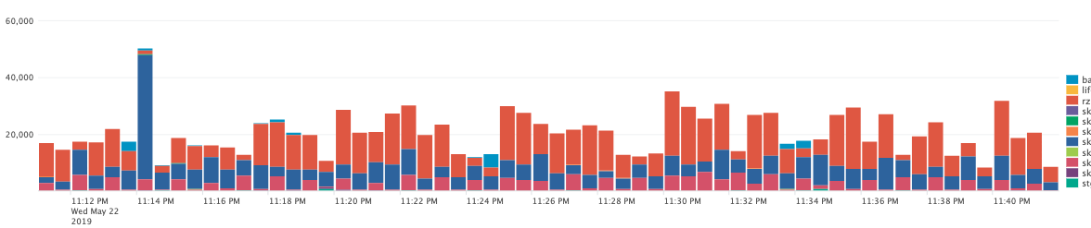
Multi SH cluster analysis
If you have multiple search heads or clusters, analyse where your workload originates from
This will help you focus your tuning effort
Analyse over long and short durations, example:
Earliest -24h, span=1d
Earliest=-2h, span=1m
Example search
https://github.com/nicovdw/splunk_concurrency_helper/blob/master/search_load_by_sh_cluster

Slide 22
Step1: Skew and Windows
Option 1: All the things
Make the following changes to savedsearches.conf
[default]
allow_skew=60s
schedule_window=auto
Option 2: Limited scope
Use the following to create REST commands to apply only to certain searches. Endless filters possible
https://github.com/nicovdw/splunk_concurrency_helper/blob/master/scoped_skew_and_window

Slide 23
Quota Management
Large user quotas for some users will cause other users to queue due to cluster wide limits reached, or if concurrency is very high, overload Splunk infrastructure momentarily
Adjust for greater good
Users with heavy dashboards SHOULD queue searches!
Protect the majority of users

Slide 24
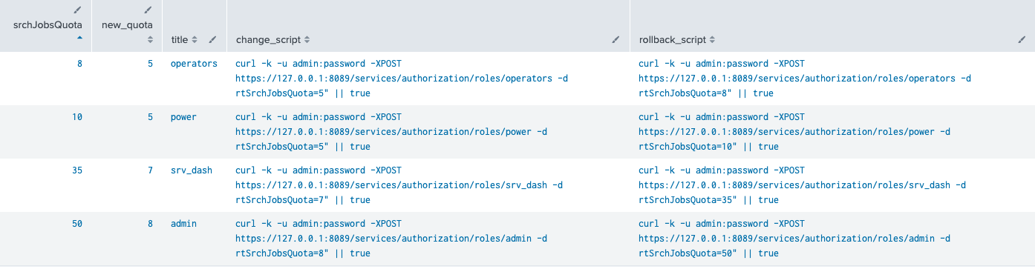
Step 3: Adjust role Search Quota
The search below provides a REST script that can be used to programmatically reduce quotas to sane levels.
Output of the change_script column can be run as a script. A rollback script is also provided
https://github.com/nicovdw/splunk_concurrency_helper/blob/master/role_quota_reducer

Slide 25
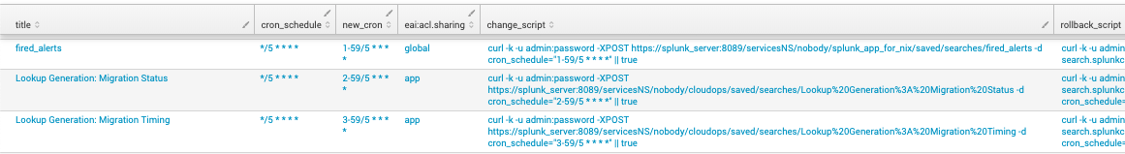
Optional step
Offset Searches Semi-Automanually
Optionally, searches can be manually moved to different offsets
For example, instead of running a search on a 5 minute interval at 0,5,10,15, etc minutes past the hour, offset some to run at 1,6,10,16, etc, and repeat for other intervals.
The search below will create a REST script to automatically offset searches scheduled to run every 5, 10, 15, 30 and 60 minutes
Scope can be tailored using endless filters, for example only on certain intervals, certain users, apps, actions, etc.
https://github.com/nicovdw/splunk_concurrency_helper/blob/master/search_rescheduler%20tool
Copy the output of the change_script column into a scrip file. Rollback script also provided

Slide 26
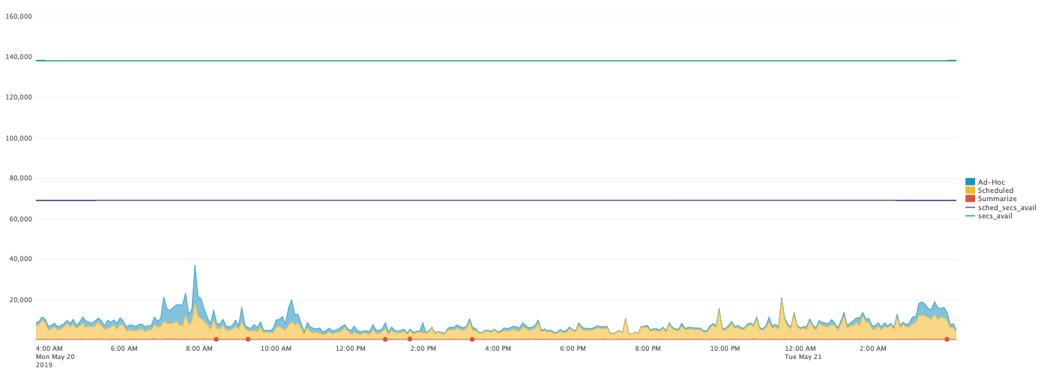
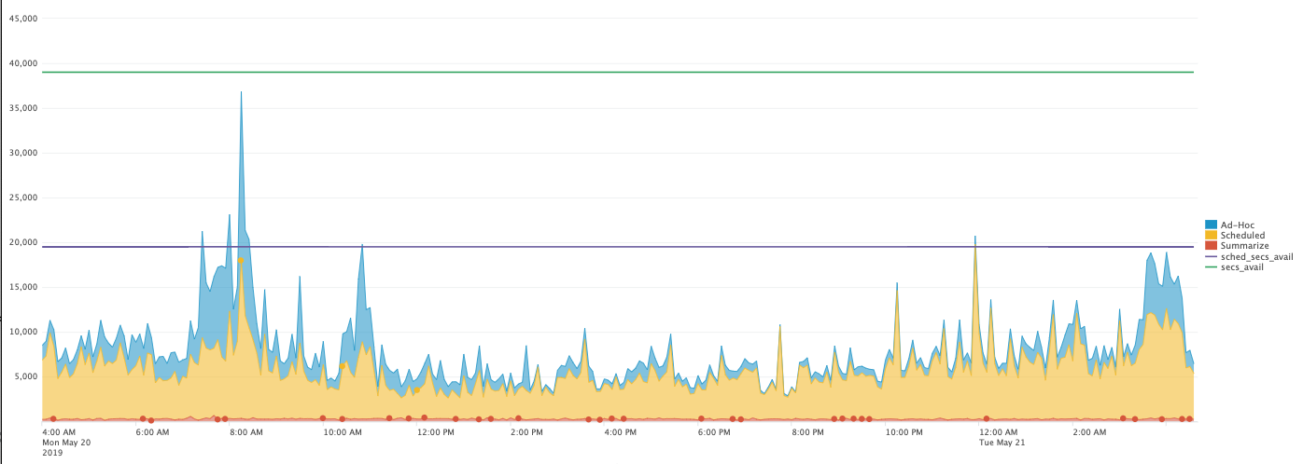
Estimate Headroom
The following search can be used to estimate total cpu seconds used vs theoretical available cpu seconds
Syntax allows for very basic modeling of headroom available at varying concurrency settings
https://github.com/nicovdw/splunk_concurrency_helper/blob/master/headroom_estimator
sh=3, max_base=28, searches_per_cpu=2, cpu_count=32, saved_search_perc=50
sh=3, max_base=26, searches_per_cpu=0, cpu_couxnt=32, saved_search_perc=50

Slide 27
Concurrency Approach
Previous steps (allow skew, schedule window, quota adjustment) are crucial. Next steps rely on them being in place
Reduce concurrency iteratively in 15 - 20% increments
Consider ad-hoc captain (Note: reduces saved search concurrency)
Measure search performance, skipped searches (reason!!!), load average, Disk I/O, search delay, etc. over time. Allow enough time to observe impact.
Iterate through all search heads and search head clusters.
Wash, rinse and repeat
Stop when instance or system wide concurrency becomes a problem, and adjust up slightly.

Slide 28
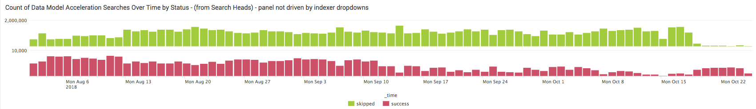
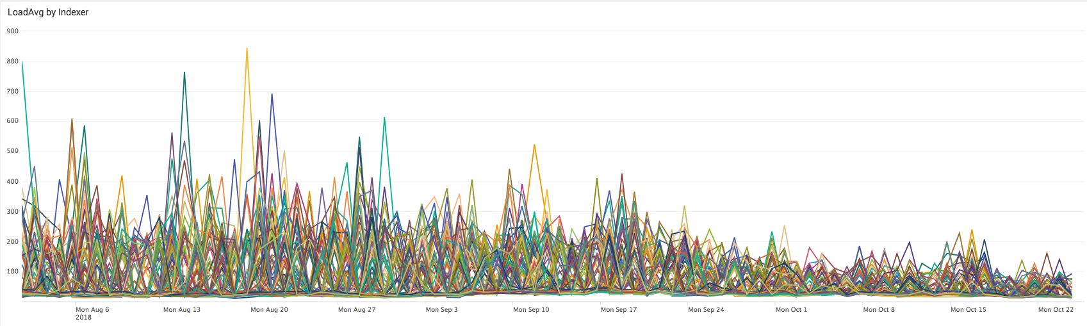
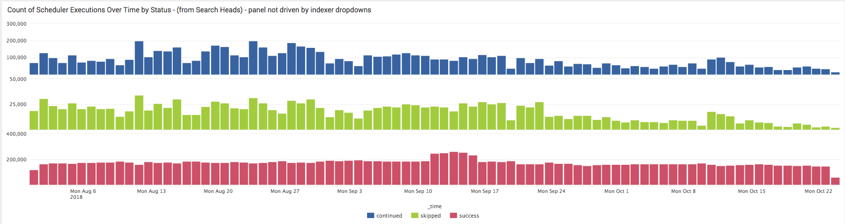
Examples

Slide 29
Bonus Stuff
The dashboards below is a one stop shop for analysing search performance of individual search performance, and is sorted by cumulative runtime for all the following categories
Searches running longer than scheduled time
Long running Saved searches
Inefficient ad-hoc searches
Inefficient dashboards
Ineficcient dashboard panel
https://github.com/nicovdw/splunk_concurrency_helper/blob/master/search_duration_analysis.xml

Slide 30

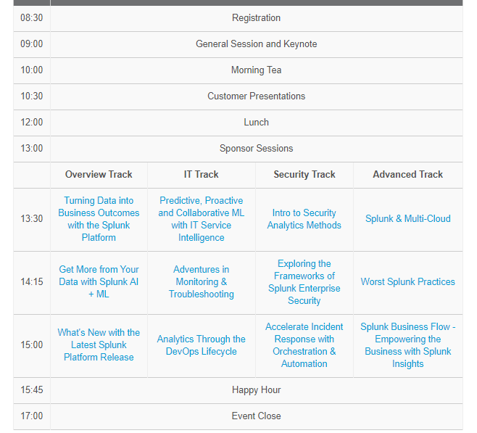
REGISTER TODAY!
Join us for our biggest event of the year!
Sydney – 21 June – Hilton Sydney
4 Breakout Tracks – Overview / IT / Security / Advanced
Great line up of customer speakers
Qantas / Atlassian / NAB / NSW Education
https://live.splunk.com/Sydney
https://live.splunk.com/Melbourne

Slide 31



Oct. 21 – 24, 2019
Splunk University | Oct. 19 – 21, 2019
The Venetian Sands Expo | Las Vegas, Nevada
Splunk .conf19 is the premier Splunk education and thought leadership event for thousands of IT and business professionals who are keen to use machine data insights to find answers.
4 Days of Innovation
350 Education Sessions
20 Hours of Networking
“ Hands down the most beneficial and attendee-focused conference I have attended!”
– Michael Mills, Senior Consultant Booz Allen Hamilton
Sign up for notifications at conf.splunk.com
Notes:
Alternate quote:
“Splunk .conf was easily the most career return on investment value of any conference available in the industry. I highly recommend attending to anyone interested in being on the leading edge of managing their data.”
– Karissa Rasmussen, Sr. Information Security Engineer, Cybercore Technologies

Slide 32
Thank You.

